Slide 1


Verdant
Programmable escrow for anything.
Non-custodial, condition-driven escrow — built on Robinhood Chain.
On Robinhood Chain
verdant-peach.vercel.app · Presale live
Notes:
Verdant is a single programmable escrow primitive: non-custodial, condition-driven, built on Robinhood Chain. The presale is live.

Slide 2




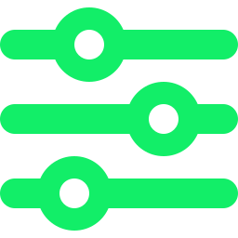

THE PROBLEM
Trust between strangers is rented — expensively.
Every deal between strangers needs trust. Today that trust is fragmented, custodial, and one-size-fits-all.
UP TO
Fragmented
Custodial
20%
A different siloed product for every use case.
A middleman holds your money to release it.
Fiverr's cut on a freelance deal — charged whether the work is good or not.
Slow & manual
One-size-fits-all
Escrow agents stay slow, manual, and custodial — they hold your money to release it.
Escrow agents settle by hand, on their timeline.
No neutral, programmable layer for trades, wagers, or agreements.
Verdant
Programmable escrow for anything
02 / 12
Notes:
The pain: trust between strangers is expensive and manual today. Fiverr takes up to 20%. Escrow agents are slow and custodial. There is no neutral programmable settlement layer.

Slide 3


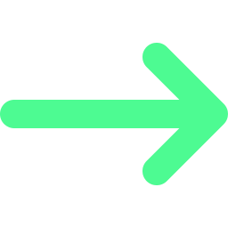
THE SOLUTION
One programmable escrow primitive.
Assets lock in a non-custodial vault and release when a configurable set of on-chain conditions is met.
Lock
Compose
Settle
Funds enter a non-custodial vault — custody never leaves the user.
Wire conditions together with ALL / ANY logic.
Release, refund, or dispute — self-executing on-chain.
Composable conditions
ALL / ANY logic
Mutual release
Timelock
Deadline
Arbiter
M-of-N multisig
Oracle attestation
Price feed
Milestones
Verdant
Programmable escrow for anything
03 / 12
Notes:
One vault primitive. Compose eight condition types with ALL/ANY logic. Same contract expresses any agreement. Self-executing, non-custodial.

Slide 4
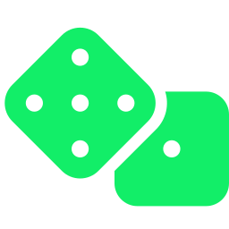



PRODUCT LINEUP
Four products. One primitive.
Templates are presets over the same vault. Drop to custom and wire any condition yourself.
Wager
Service / Gig
P2P Trade
Agreement
Stake it. Winner takes the pot.
Fiverr-style milestone escrow — pay as work lands.
Swap assets or goods with a safety net.
Put money behind any promise.
Oracle OR Deadline
Milestone + Deadline + Arbiter
Mutual release + Deadline
Mutual + Arbiter + Timelock
Verdant
Programmable escrow for anything
04 / 12
Notes:
Wager, Service/Gig, P2P Trade, Agreement — all the same vault with different condition wiring. Templates are just presets; custom wiring is available.

Slide 5


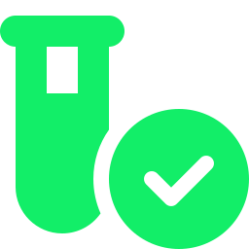
BUILT, END TO END
The whole stack is live today.
Not a concept deck — a working product. A live demo and presale are already running.
Web app
One spine, four layers
Create wizard, dashboard, and escrow detail — build, fund, track, and settle.
Web dApp
Next.js — build, fund, settle
SDK + API
A typed TypeScript SDK for integrators, plus a REST API and indexer.
SDK + API
Typed client · REST · indexer
~150 automated tests
packages/shared
Source of truth: types, fees, chains
Fully typed, contracts-to-web, mirroring on-chain structs 1:1.
Contracts
Foundry · Solidity · Arbitrum Orbit
Live demo + presale running
Verdant
Programmable escrow for anything
05 / 12
Notes:
The product exists end to end: web app, SDK, API/indexer, ~150 automated tests, all typed off one shared spine. Live demo and presale already running.

Slide 6



REVENUE MODEL
We earn only when the deal works.
1% on successful release — nothing on create, nothing on refund. Split 50/50, hard-capped on-chain.
More ways it earns
Protocol take-rate vs. peers
Arbitration fee
Fiverr
~20%
20% protocol cut — refunded to the winner.
Idle-funds yield
Kleros
~5%
Optional, principal-guaranteed; 50% of yield.
White-label rails
Verdant
1%
Builder fees for integrators (up to 2%).
1% base · 3% hard ceiling · $500 per-deal cap — every parameter on-chain.
Premium & subs
Power-user and template upsells.
We win on price and trust.
Verdant
Programmable escrow for anything
06 / 12
Notes:
Success-only 1% fee aligns incentives, split 50/50, capped on-chain (3% ceiling, $500/deal). Additional streams: arbitration cut, opt-in yield, white-label, subscriptions.

Slide 7


WHY NOW
Robinhood Chain just went live.
An EVM L2 for tokenized real-world assets across 120+ countries. That economy needs an on-chain settlement layer.
Global by default
On-chain assets need on-chain deals
The model that sticks
Tokenized stocks and RWAs across 120+ countries on one EVM chain.
Tokenized value needs programmable agreements — escrow is that settlement layer.
Non-custodial and programmable is what users and regulators will accept.
Chain live
RWAs tokenize
Agreements settle on Verdant
Verdant
Programmable escrow for anything
07 / 12
Notes:
Robinhood Chain is live: an EVM L2 for tokenized RWAs across 120+ countries. Tokenized assets need on-chain agreements; escrow is the settlement layer. Non-custodial + programmable is the accepted model.

Slide 8



SECURITY & TRUST
Built to be trusted with money.
Non-custodial by design — principal always returns to the rightful party.
Non-custodial
INTERNAL AUDIT
Funds live in the contract; principal returns to the rightful party.
0
Adversarial audit
6 independent lenses, 3-way verification, iterated to zero findings.
open findings
No predatory incentives
Success-only fees; winner-refunded arbitration; caps enforced on-chain.
33 issues fixed — every critical and high resolved and regression-tested.
External audit gated
A professional external audit is required before mainnet.
Verdant
Programmable escrow for anything
08 / 12
Notes:
Non-custodial: principal always returns to the rightful party. Internal adversarial audit — 6 lenses, 3-way verification — iterated to zero open findings; 33 issues fixed. External professional audit gated before mainnet.

Slide 9



ROADMAP
From testnet to the settlement layer.
NOW
NEXT
THEN
Live on Robinhood Chain testnet
External audit → mainnet launch
Cross-chain via bridges
Presale open
On-chain arbitration marketplace
Institutional / OTC escrow
Internal audit complete
Idle-funds yield
White-label rails
Verdant
Programmable escrow for anything
09 / 12
Notes:
Now: live on testnet, presale open, internal audit complete. Next: external audit and mainnet, arbitration marketplace, yield. Then: cross-chain, institutional/OTC, white-label.

Slide 10
WHERE WE ARE
Pre-launch — but everything is built.
Honest status: the protocol exists end to end and the presale is open.
Full stack shipped
Audit converged clean
Live demo running
Presale open
Contracts + SDK + API + web, all typed.
Internal audit iterated to zero findings.
Build, fund, and settle escrows today.
Back the protocol now.
Kept honest
Pre-launch: no user counts or revenue to report yet. Those numbers come after mainnet — this deck states only what is true today.
Verdant
Programmable escrow for anything
10 / 12
Notes:
Pre-launch status kept deliberately honest: full stack built, internal audit clean, live demo and presale open. No invented user or revenue metrics — those follow mainnet.

Slide 11
THE ASK
Presale is live. Back the protocol.
Fund the path to mainnet. Allocation and raise target below are placeholders for the founder to finalize.
Dev
40%
Engineering to mainnet and beyond.
Liquidity
25%
Protocol liquidity and market depth.
Audit + bounty
20%
External audit and ongoing bug bounty.
Growth
15%
Distribution, integrations, and community.
Raise target: [ TBD ]
Presale live at verdant-peach.vercel.app/presale
Use of funds
[ PLACEHOLDER ALLOCATION ]
Verdant
Programmable escrow for anything
11 / 12
Notes:
Use of funds: external audit + bug bounty, mainnet, liquidity, growth. Allocation percentages and raise target are placeholders for the founder to finalize. Presale is live.

Slide 12
Verdant
Programmable escrow for anything.
verdant-peach.vercel.app/presale
Presale live · [ contact / @handle — TBD ]
Notes:
Programmable escrow for anything. Presale live at verdant-peach.vercel.app/presale. Contact handle is a placeholder for the founder.

